Slide 1

Project 1
Pankaj Rampal, Gaurav Aneja, Munir Makani

Slide 2
Hypothesis and Data collection Outline
Hypothesis = Air Quality in NYC Metropolitian Area Improved during Corona Virus Period from Jan 1, 2020 to Dec 31, 2020 that could lead to better health outcomes for NYC residents in the long run
Air Quality data parameters: Counties and district counties of NYC area, Ozone, Black Carbon, NO2, NO, SO2, Fine Particulate Matter
Corona Virus data parameters: Counties and district counties of NYC area, COVID cases per day, COVID Deaths, cumulative COVID cases, Ozone, Black Carbon, NO2, NO, SO2, Fine Particulate Matter
Data period: 2009 to 2018 yearly, 2020 daily where observations are available for counties in NYC

Slide 3
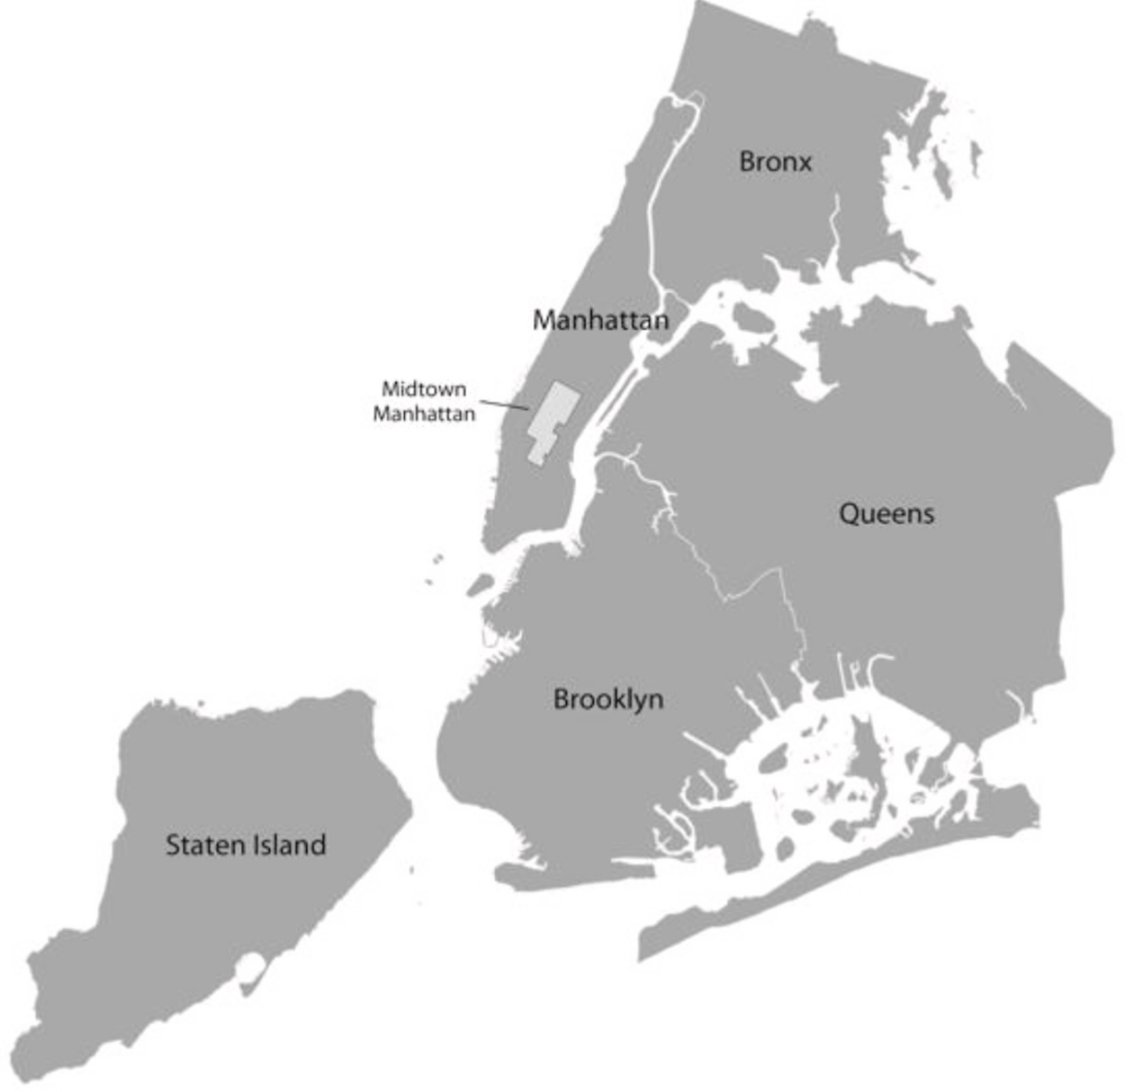
NYC Metropolitan Area
New York is the largest metropolitan area of the US and contains a population of approximately 8.4 million and has population density of 27,750 people per square mile as per NYC data, 2018.
NYC is divided into 5 boroughs, Manhattan, Bronx, Queens, Brooklyn and Statan Island.
Our area of study is all the boroughs of NYC and their counties

Slide 4
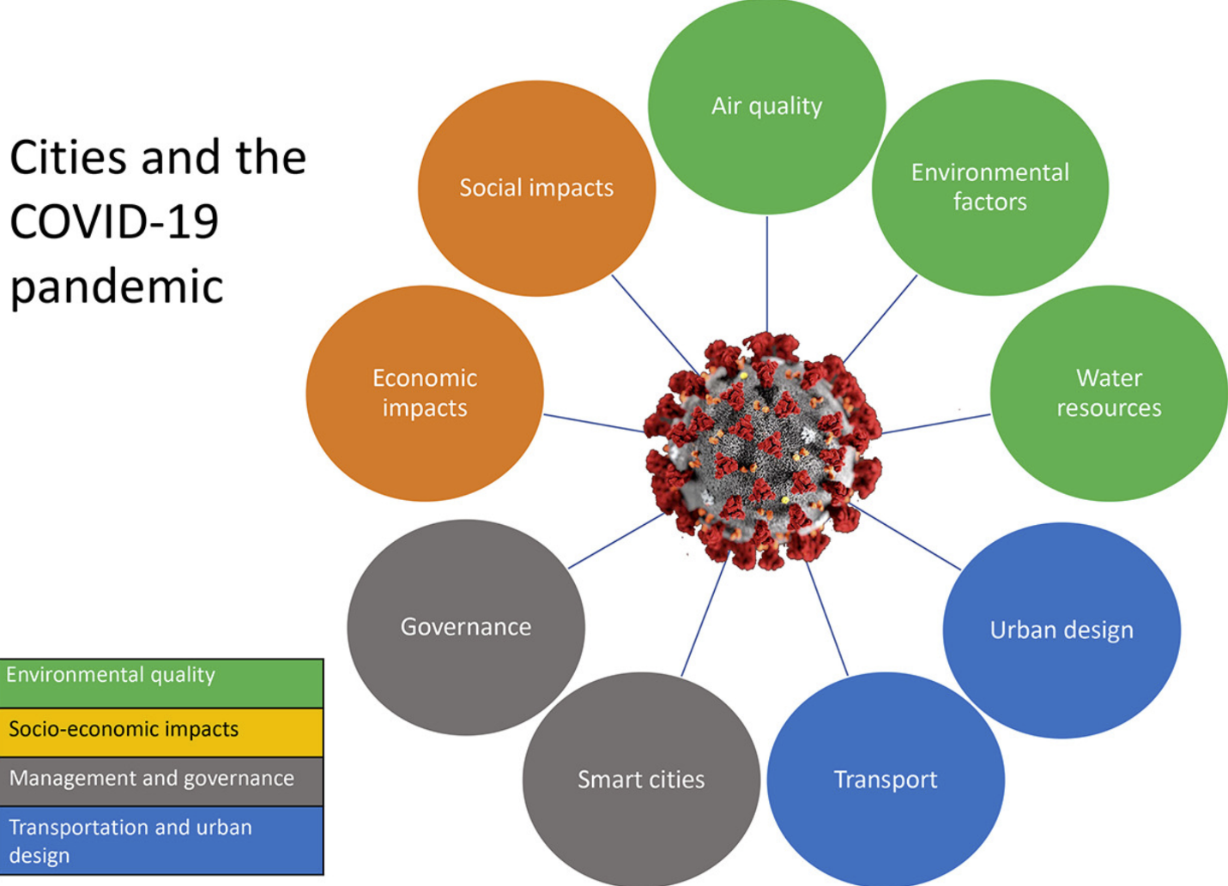
Research Methodology
Out of various impacts of COVID 19 across various sectors, we have chosen to focus our analysis on impact on Air Quality across NYC Metropolitan area and establish if this could eventually have better health quality in the long run

Slide 5
Air Quality parameters
1. Ozone:
Ground level ozone is not emitted directly into the air, but is created in the air itself by chemical reactions between oxides of
nitrogen (NO_{x}) and volatile organic compounds (VOC). Ozone forms on hot sunny days when pollution from cars, power plants,
consumer products and other sources react with sunlight.
2. Black Carbon
BC is produced both naturally and by human activities as a result of the incomplete combustion of fossil fuels, biofuels, and
biomass. Primary sources include emissions from diesel engines, cook stoves, wood burning and forest fires.
3. Fine Particulate Matter PM 2.5
Some are emitted directly from a source, such as construction sites, unpaved roads, fields, smokestacks or fires. Most particles form
in the atmosphere as a result of complex reactions of chemicals such as sulfur dioxide and nitrogen oxides, which
are pollutants emitted from power plants, industries and automobiles.
4. Nitrogen Dioxide and Nitrogen Oxide
NOx is produced from the reaction of nitrogen and oxygen gases in the air during combustion, especially at high
temperatures. transportation, industrial process, commercial and residential households, energy use in indury etc;
5. Sulfur Dioxide
SO2 forms when sulfur-containing fuel such as coal, oil, or diesel is burned. Sulfur dioxide also converts in the atmosphere to sulfates,
a major part of fine particle pollution in the eastern U.S.

Slide 6
Health Impact of Parameters
1. Ozone:
Eye irritation, chest pain , coughing, shortness of breath and decreased lung function, Increased susceptibility to
respiratory infections, Increased likelihood of asthma attacks. Inflammation of the lungs
Ozone can worsen bronchitis, emphysema, and asthma, leading to increased medical care.
2. Black Carbon
Black carbon, can cause premature death and harmful effects on the cardiovascular system (the heart, blood, and blood
vessels). health problems, including respiratory diseases.
3. Fine Particulate Matter PM 2.5
Short term Impact in eye, nose, throat and lung irritation, coughing, sneezing, runny nose and shortness of breath. Exposure to fine
particles can also affect lung function and worsen medical conditions such as asthma and heart disease.
4. Nitrogen Dioxide and Nitrogen Oxide
NOx causes asthma and potentially increase susceptibility to respiratory infections. People with asthma, as well as children and the
elderly are generally at greater risk for the health effects
5. Sulfur Dioxide
High concentrations of SO2 can cause inflammation and irritation of the respiratory system,

Slide 7
Research Methodology
Historical yearly data of Air Quality parameters is obtained from publicly available sources
Dataset cleaned and merged into single data frame.
Dataset is diescted as per counties for six Air Quality Parameters and is mapped in a bar graph and line graph to understand trend of Air Quality parameters over from 2009 to 2019
Each Air Aquality parameter is also analyzed to understand trend of a particular parameter over the period from 2009 to 2019
Selected parameters are mapped on scatter plot to identify data points per counties and districts that are outliers and have exhibited best or worse Air Quality and understand any correlation between these parameters to help focus on key parameters
Data frame for NYC and its five boroughs Manhattan, Bronx, Brooklyn, Queens and Statan Island is created and Air Quality Parameters are mapped for these Boroughs and data is mapped into box plot to understand variation of data points from its mean and outliers
Data frames for top ten and worst ten counties/ districts is created based on Air Quality Parameters

Slide 8
Observations- Historical 2009-2019
New York City grapples to find solutions for its pollution problems. As per American Lung Association, more strict controls could save potentially more than 3,000 lives per annum in the NYC metropolitan area
There has been downward trend of air quality pollutants in NYC metropolitan area from 2009-2019
NYC is phasing out high sulfur heating oil that has already provided substantial health benefits and reduced city-wide SO2 levels by more than 70%;
A cap-and-trade initiative in US that is designed to reduce greenhouse gas emissions from electric power generating units had potentially decreased power sector CO2 emissions by more than half since 2005;
Initiatives of State Implementation Plans for curbing air pollutants e.g. SO2, CO2, PM 2.5 etc across NYC metropolitan area from various sectors including infrastructure transportation, sewage, etc
Regulatory initiatives across NYC Metropolitan area,
NYC Plan 2030 launched in 2007 to reduce PM. 2.5, SO2, NOX, CO2, Black Carbon etc levels from heating oil, burning fuel, industrial activity, across NYC Metropolitan area;
Manhattan is the most affected geography across majority of air pollution parameters

Slide 9
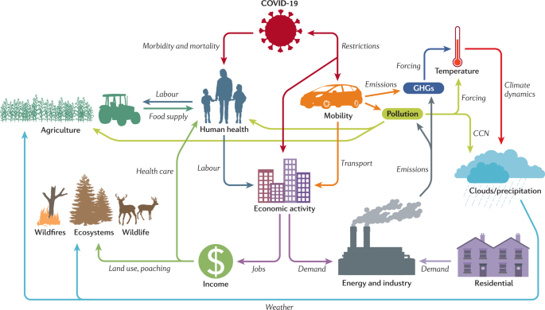
The COVID-19 lockdowns: a window into the Earth System
Earth System interactions linked to the COVID-19 socioeconomic disruption.

Slide 10
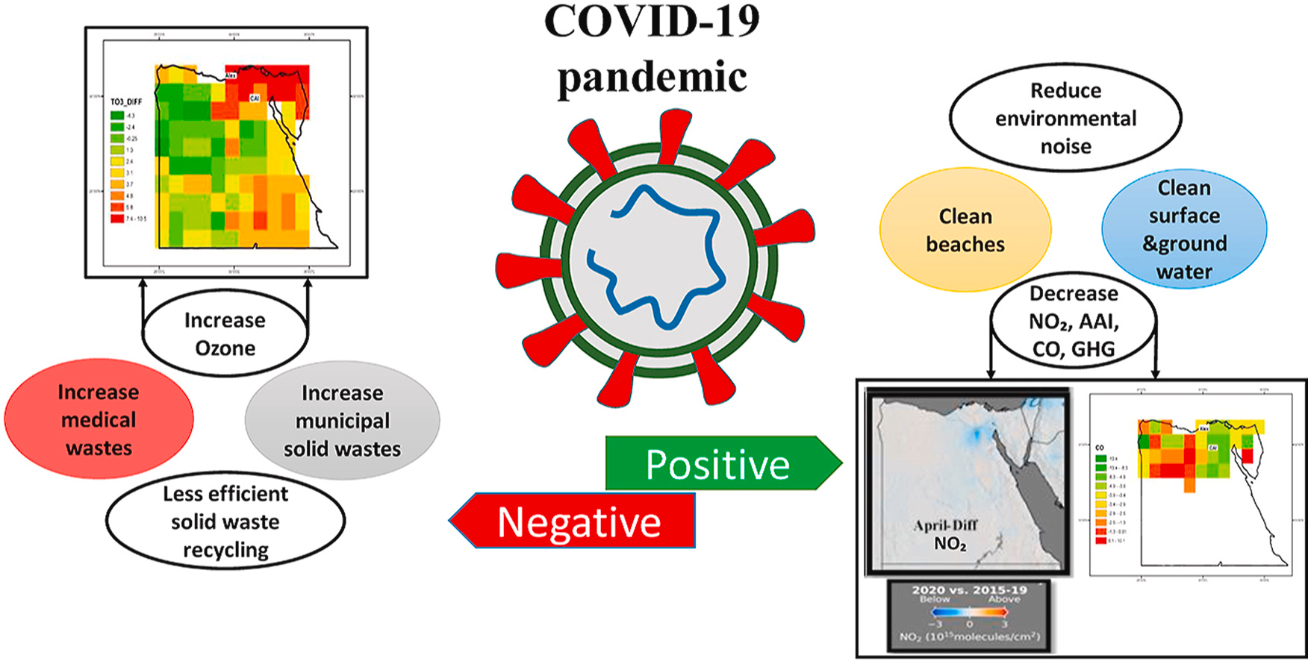

Slide 11
NYC and COVID
First case of COVID in Wuhan China in Dec 2019. First COVID case in US on January 21st. Until Feb 23rd, 14 COVID cases in 6 states. First COVID case in NYC on March 1, 2020. March 11,2020 WHO declared COVID as Pandemic.
March 20th, NYC Governor placed placed stay-at-home executive order. April 4th, 2020 confirmed cases were 12,000.
New York city accounts for 4% of US cases and 13% of US deaths, as of data released.
NYC accounts for 1% of global cases and 3% of global deaths.
NYC accounts worst Air pollutants across the county and Borough.
NYS unemployment rate highest across the US.
New York state hospitals will face between $20-$25 billion in losses and new expenses through April 2021.
$14.5 billion projected revenue decline for FY 202, a $1.2 billion decline from revenue estimates made in April.

Slide 12
COVID - 19 lockdowns temporarily raised global temperatures, research shows reductions in aerosol emissions had slight warming impact
Higher levels of the tiny, dangerous particles in air known as PM 2.5 were associated with higher death rates from the disease.
Various other factors that are known to affect outcomes, like smoking rates, population density and poverty levels.
Its proven that people who live in areas with high levels of pollution are 15 percent more likely to die from the COVID - 19.
Air pollution result in increase risk of Autism.
The positive impact of COVID-19 is seen in 1% dip in crime as against to 2019.
Health systems and providers would have been able to share data in real-time to allow for better insight into the impacts of COVID-19

Slide 13
Observations- COVID period
Decrease in Air pollution can be linked to the lockdowns enforced during Covid
Traffic in some of NYC’s busiest areas decreased by 60%
Voluntary and mandatory restrictions impacted metro airport activity construction, electricity generation, restaurant operation and office building occupancy
By quantifying the potential public health benefits of a clean air, low emission scenario, this analysis should incentivize policymakers to strengthen initiatives on climate change and air pollution.
Traffic emissions are major sources of pollution in NYC. Non-traffic sources of pollution are also important in some contexts. In some contexts, COVID-19 transmission/mortality rates are strongly associated with high levels of air pollution
Long-term exposure to air pollution can increase human vulnerability to pandemics.
The correlation show lockdown has positive impact on the environment as it has lower the air pollutant levels significantly

Slide 14
Possible Outcomes- Health Benefits
While there could be substantial improvement in air quality from COVID-19 pandemic lock-down and other measure taken by state and city of NYC, this could help offset the harm inflicted by one of the largest public health disasters in recent history.
Should the impact of COVID be not temporary or short-run and can sustain in the longer run, this could exhibit the following improvements in health-related areas and can have dollar value saving to the public and private healthcare system.
Reduced asthma incidences
Reduced asthma hospital admissions and emergency department visits,
Reduced autism spectrum disorder
Increase adult mortality.
Increased immunity levels against future outbreak
Patients would have been able to access care more locally in their as well as be more readily connected to virtual care.

Slide 15
Sources
www1.nyc.gov: http://a816-dohbesp.nyc.gov/IndicatorPublic/Subtopic.aspx?theme_code=1,4&subtopic_id=122
https://www.ncbi.nlm.nih.gov/
https://blogs.ei.columbia.edu/2016/06/06/air-quality-pollution-new-york-city/
https://www.nature.com/articles/s43017-020-0079-1
New York Times
The contribution of urban areas to climate change: New York City case study by Masahiko Haraguchi
New York City Panel on Climate Change 2019 Report Chapter 9: Perspectives on a City in a Changing Climate 2008–2018 by William Solecki1 and Cynthia Rosenzweig2
Air quality changes in New York City during the COVID-19 pandemic by Shelby Zangari a, Dustin T. Hill b,c, Amanda T. Charette a,b, Jaime E. Mirowsky a,b,⁎
The COVID-19 pandemic: Impacts on cities and major lessons for urban planning, design, and management Ayyoob Sharifi a,b,c,⁎, Amir Reza Khavarian-Garmsir d
Potential health benefits of sustained air quality improvements in New York City: A simulation based on air pollution levels during the COVID-19 shutdown Frederica Perera a,*, Alique Berberian a, David Cooley b, Elizabeth Shenaut b, Hollie Olmstead c, Zev Ross c, Thomas Matte d

